Slide 1

INDOOR POSITION DETECTION SYSTEM
A WIFI RSSI-BASED ANDROID APPLICATION
Supervised By
Dr. Shamim Al Mamun
Professor
IIT, JU

Slide 2



OUR TEAM
A S M Mehedi Hassan
Exam Roll: 220545
Jubayer Bishwas Shadin
Exam Roll: 220549
Hrishikesh Kanu Bintu
Exam Roll: 220554
Hrishikesh Kanu Bintu
Exam Roll: 220554

Slide 3
INTRODUCTION
Indoor navigation is difficult where GPS signals are unavailable.
WiFi RSSI can estimate indoor user location.
Our system provides offline indoor position detection.
Designed for educational and institutional environments.

Slide 4
OBJECTIVES
1
Detect indoor location using WiFi signals.
2
Estimate user position without GPS.
3
Display real-time signal information.
4
Provide an easy-to-use Android application.

Slide 5



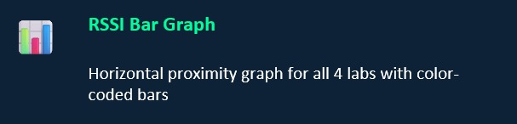


SYSTEM FEATURES

Slide 6





TECHNOLOGIES USED
Kotlin Programming Language
Android Studio
XML User Interface
WiFi RSSI Technology
Canvas-based Custom Views

Slide 7
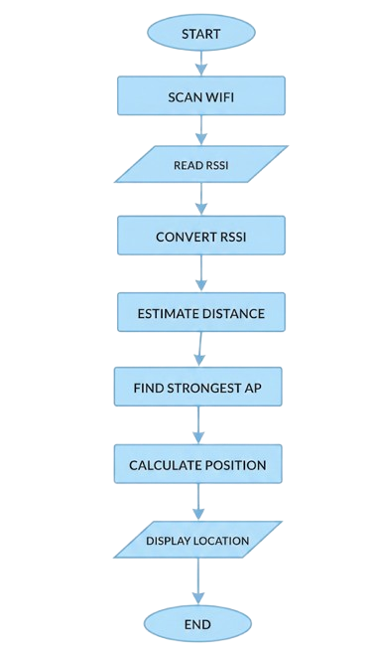
SYSTEM FLOWCHART

Slide 8
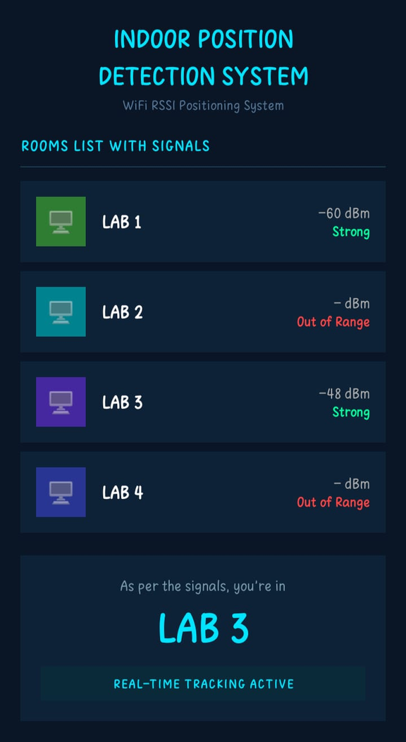
APP DEMONSTRATION
Title & subtitle with real-time status
Each lab row: RSSI in dBm + quality label
Color-coded: Green → Cyan → Amber → Red
Detected lab displayed prominently below

Slide 9
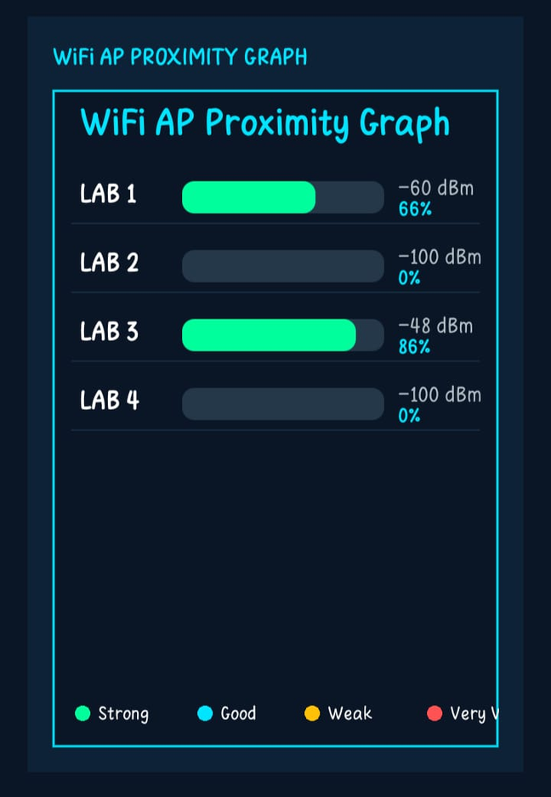
APP DEMONSTRATION
Shows real-time RSSI signal strength of all 4 WiFi access points.
Helps identify the nearest and strongest router.
Color-coded bars indicate signal quality levels.

Slide 10
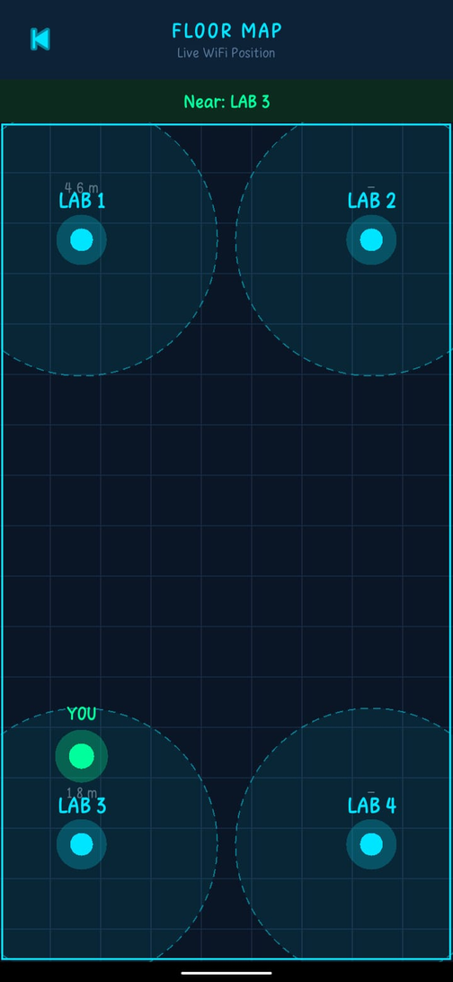
APP DEMONSTRATION
Cyan dots = WiFi access point routers
Dashed circles = estimated signal coverage zone
Green dot 'YOU' = estimated current position
Position updates live with every WiFi scan

Slide 11
BENEFITS

Slide 12
LIMITATIONS
1
RSSI fluctuates due to obstacles.
Accuracy depends on router placement.
2
3
Supports only a single mapped floor.
4
Android limits WiFi scan frequency.
5
Uses four predefined routers.

Slide 13
FUTURE IMPROVEMENTS
Multi-Device Monitoring
Device Information Management
Improve localization accuracy.
Integrate AI-based positioning.
Support multiple floors.

Slide 14
THANK YOU

